Slide 1


Slide 2
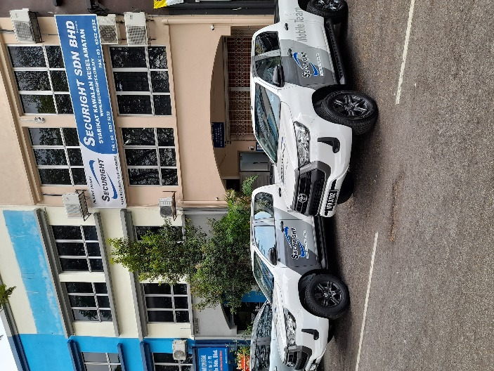
COMPANY BACKGROUND
Securight Sdn Bhd was incorporated in 2008. At the outset the Board of Directors had a bold vision - to be the best! Our first task was to assemble a team of professional and experienced managers whose mandate was to mould our organization into one of the foremost commercial security companies in Malaysia.
A market survey revealed several weaknesses and challenges within the industry and the main cause identified was the untrained and poorly disciplined guard force. Our priority was on training and more training; in order to enable us to provide our clients with quality security services.
Our priority remains customer satisfaction. With our international experience, support and local expertise achieved through a combination of dedicated management and a highly trained guard force, we are committed to providing professional security services unmatched in Malaysia.
SecuritasThailand
The Trendy Office Building 10/120, 10th Floor, Sukhumvit Soi 13, Klongtoey Nua, Wattana, Bangkok 10110
Phone + 66 (0)2 168 7400 Fax + 66 (0)2 168 7402
info@securitas.co.th
www.securitas.co.th

Slide 3










OUR CLIENTS

Slide 4

LIST OF SERVICES

Slide 5
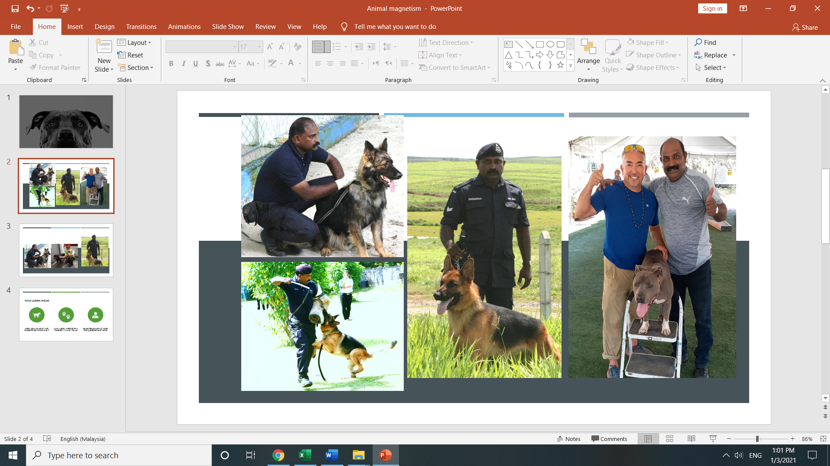
K9 UNIT
We have a dedicated dog handler and trainer who has worked with the Police K9 Unit.
Our dogs provided by the trainer Mr. Ravi are well trained guard dogs and are all vaccinated and certified fit for duty.

Slide 6

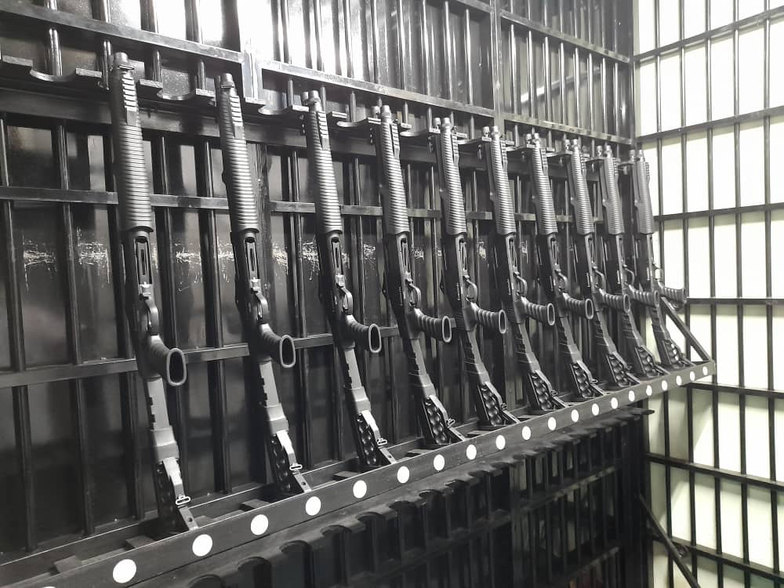
SECURIGHT ARMED ESCORT DIVISION
Securight in wanting to have an edge over its competitors in the Security industry, had embarked and established the Armed Escort Division as part of its expansion program to further empower our Business in this field of Security.
Our Head of Armory and Arms Escort Division is Mr. Jaswant Singh a retired 40 year police veteran whose last position was as Head of the Kepong Police station. Our Escort Supervisor En Mustapah is a retired 21 year veteran who served in the Malaysian Armed Forces. We have an experience team who comply to our strict SOP’s for the safe and efficient delivery of consignments.

Slide 7
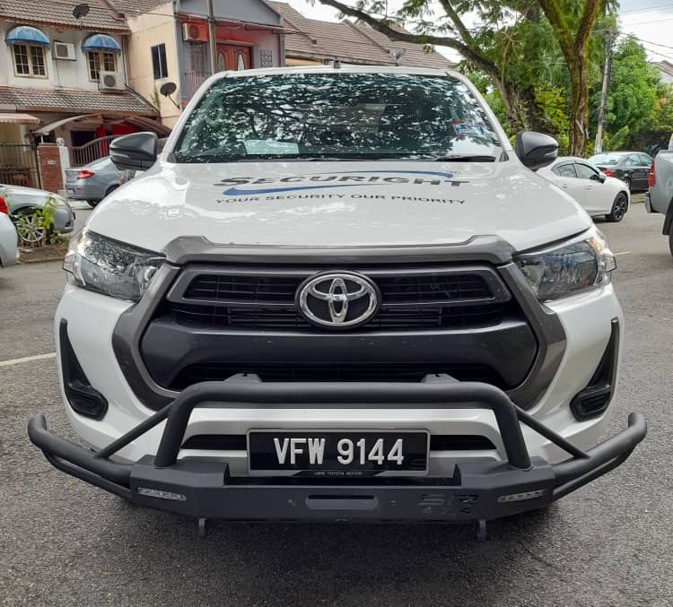
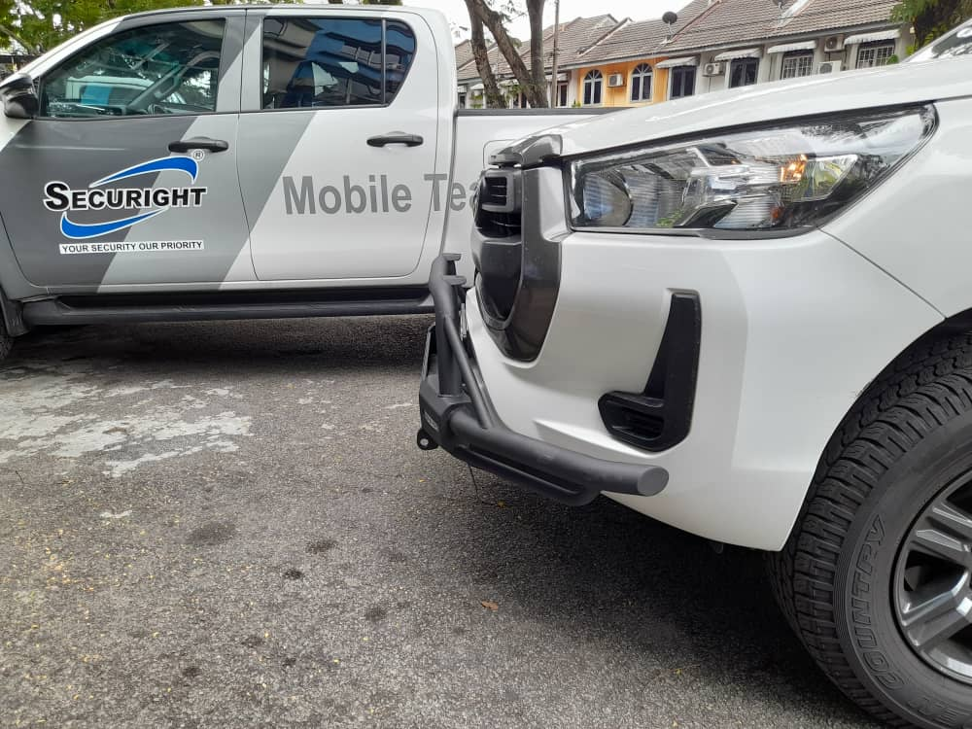
ESCORT VEHICLE FEATURES
Our New 2021 Registered 4x4 Armed Escort Vehicles are fully equipped with the following:
Two way communication system
Front rear and in-cabin audio and video 24-hour recording cameras.
Panic button for emergency response by Command Centre.
Two tier data recording system where the live feed from the vehicle’s camera’s are stored both in the vehicle black box and at our Command Centre.
GPS Tracking system.
Bull Bar for emergency collision impact.
The Vehicles GPS tracking system allows us to monitor every aspect of its journey, stops and routes and allow us to respond any emergency situations.

Slide 8
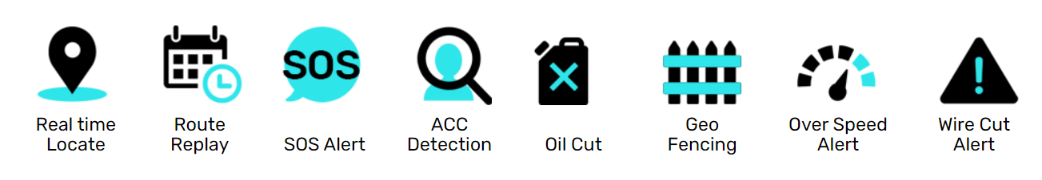
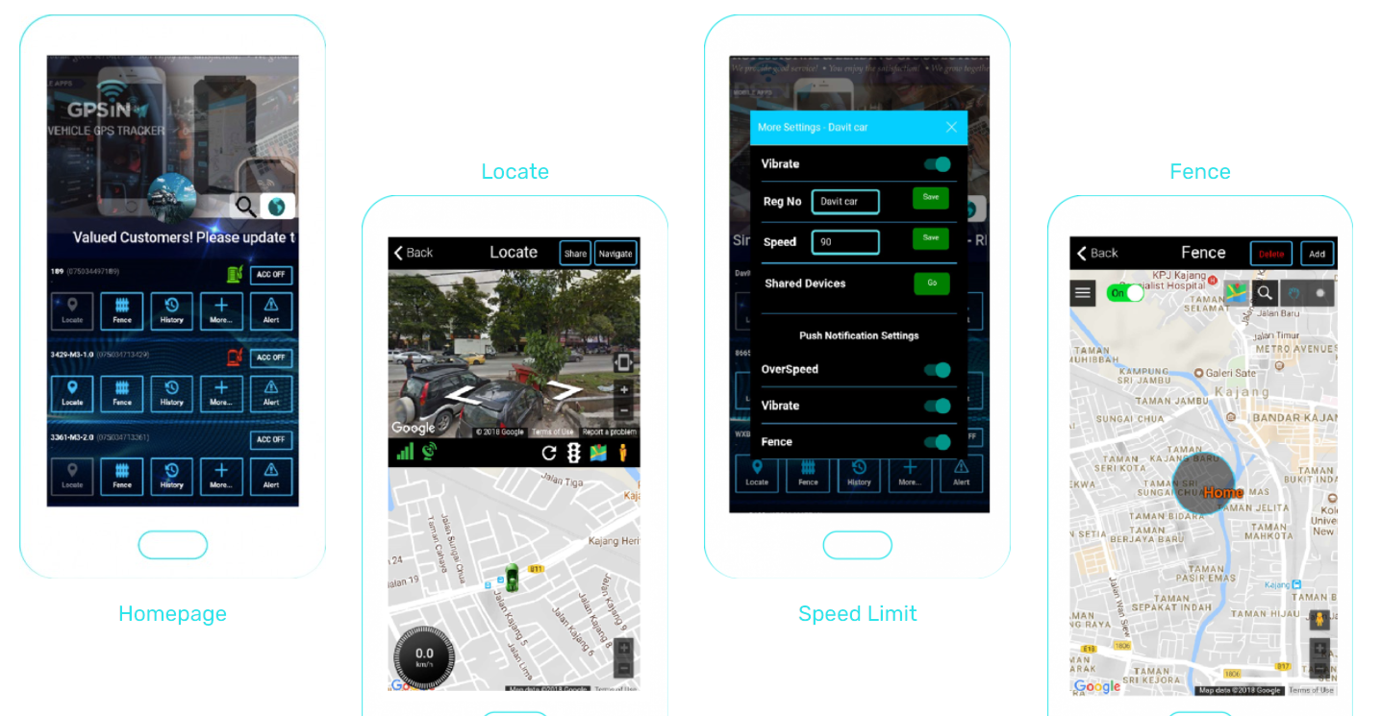
GPS TRACKING SYSTEM

Slide 9
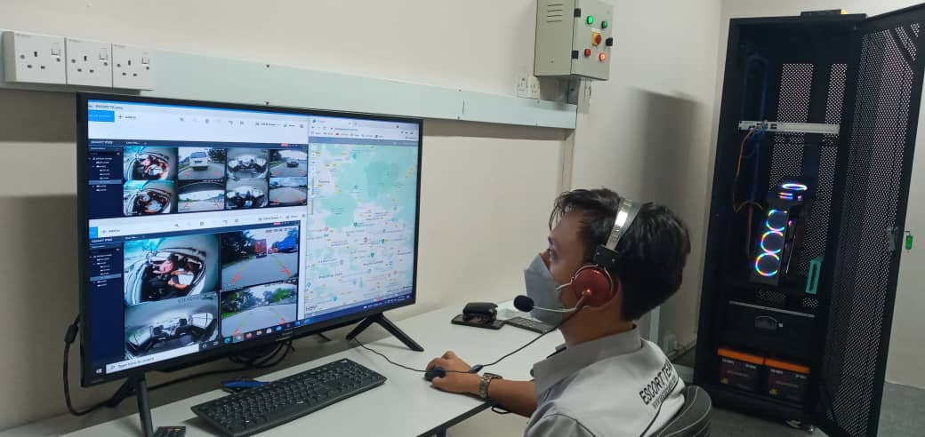
CENTRAL COMMAND CENTRE (CCC)
Our command Centre encompasses a variety of systems and solutions coming together to provide a common operational picture, mitigate threats and promote enhanced communication and response during incidents of any nature.
The live feed cameras, GPS system, panic button in the escort vehicles allows our Command Centre controller to monitor each trip closely and increase preparedness.
The Video data recording is stored both in the vehicle black box and our command Centre. Our two tier recording system is to ensure there's no loss of Data in the event the vehicle is compromised in any manner. Data is key to mitigate security Investigations, it allows investigators to complete their tasks in a far efficient and timely manner with surveillance footage, timestamps, and more data at your disposal, we can use all this information to quickly close the case. Investigations can become complex when very little information is available—our Security system eliminates any and all obstacles and can also lower the cost of an investigation.

Slide 10
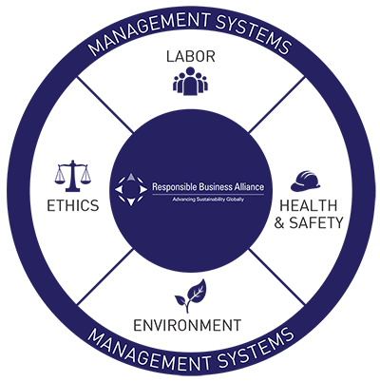

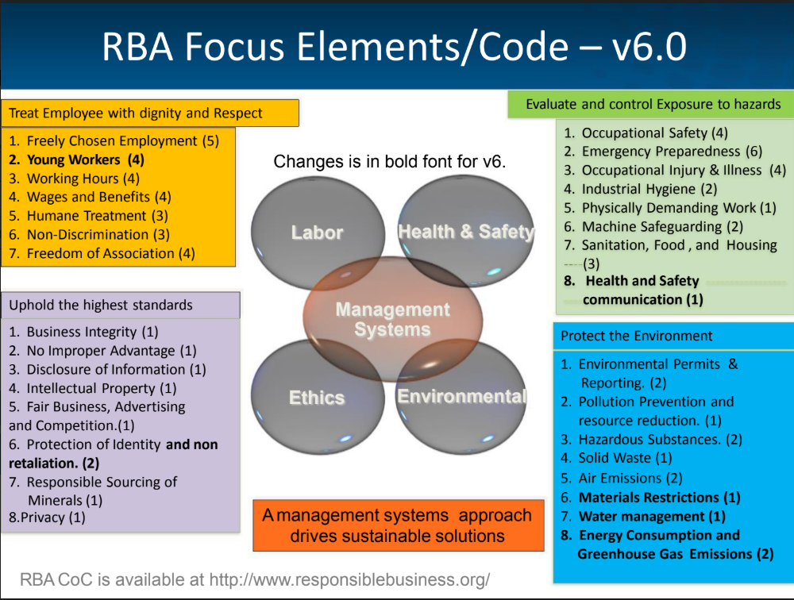
COMPLIANCE

Slide 11

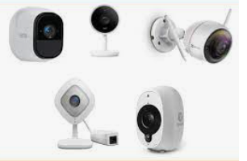

SECURIGHT ENHANCEMENT PROGRAM
Securight in wanting to have an edge over its competitors in the Security industry, has embarked on an expansion program in its Services offered to empower our Business.
Realizing that the future is about Technology and AI and less on physical presence, we are meeting today’s challenges to prepare for the future by integrating AI solutions.
We are closely working with software companies in the Industry to move towards using Algorithms and AI to influence threat landscape in the digital, physical domains of various industry ecosystems. We will be in the near future recommending to our stakeholders / clients, once we have thoroughly analyzed the development of core technologies related to the Security Industry, the Advent and complimentary use of AI at their facilities.
The main functionalities and the dependability of a security system will be specifically tailored to an organization i.e our clients comprising of heterogenous intrusion detection, access control, intelligent video surveillance and sound detection devices, which will be integrated into a cohesive Security Management System (SMS). Video analytics, smart cameras and sensors with intelligent algorithms for video and audio surveillance are all in the pipeline and being considered by Securight in its move to the future.

Slide 12


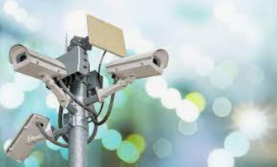

SECURIGHT PRIVATE INVESTIGATIONS (SPI)
SPI the Security Intelligence wing of Securight was set up to complement and support Securights Security guard service to our Clients. This wing was necessitated to undertake investigations of crimes perpetrated to defraud Companies by nefarious organised syndicates and individuals.
Our Intelligence services are handled by experienced Professionals and Operatives from a host of Law enforcement agencies and we offer the best strategy to defend your Interest with discretion as we evaluate your request meticulously prior to embarking on a particular Investigation.

Slide 13
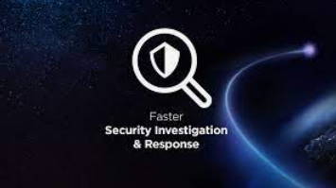


Intelligence and Investigation services include the following;
Corporate and Business Intelligence
Due Diligence on Corporation and Individual
Cyber Crime Investigations
Cyber Security Services
Security Risk Consulting
Operational Security Services
Anti-corruption Services
Asset search and tracing
Bankruptcy Search
Litigation & Criminal Records Search
Employment Verification
Intellectual Property and Patents Protection and Investigations
Background Check
Surveillance & Counter Surveillance
Skip tracing
Fraud and Crime Investigations
Undercover Investigations
Accident Investigations
Arson Investigations
Aviation Investigations
Bank Searches
Civil Investigations
Computer Crimes Fraud

Slide 14
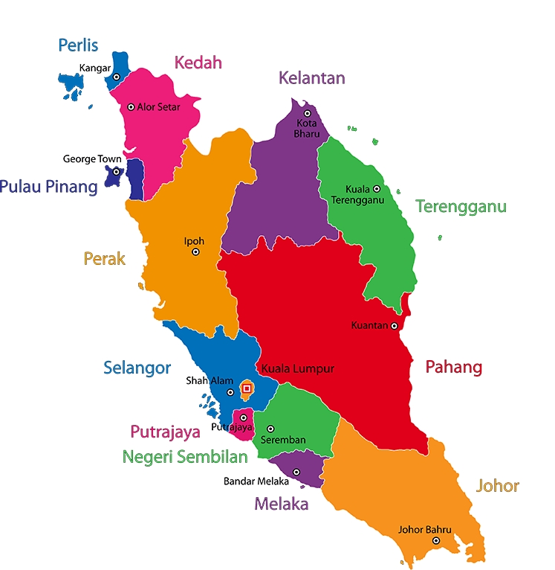

Securight to meet the demands of Companies facing Fraudsters, thievery, Corruption and Bribery and Scams and a myriad of nefarious characters within their Organization, we have added on another Wing SECURIGHT PRIVATE INVESTIGATIONS, which will be manned by Operatives who are ex-law enforcement personnel. We will handle all investigations, surveillance, reporting, and collation of evidence amongst other services which will be provided.
In furtherance we are also spreading our wings to have a presence in other states. We are already in Singapore (Securight Solutions), JB, KL & Selangor, and now we will be moving towards Perak, Penang and Kulim Kedah. Our focus are Multi Nationals and local conglomerates operating in the dozens of Industrial estates around that region.
Present Business Location
KUALA LUMPUR
SELANGOR
JOHOR BAHRU
SINGAPORE
PERAK
PENANG
KULIM KEDAH

Slide 15

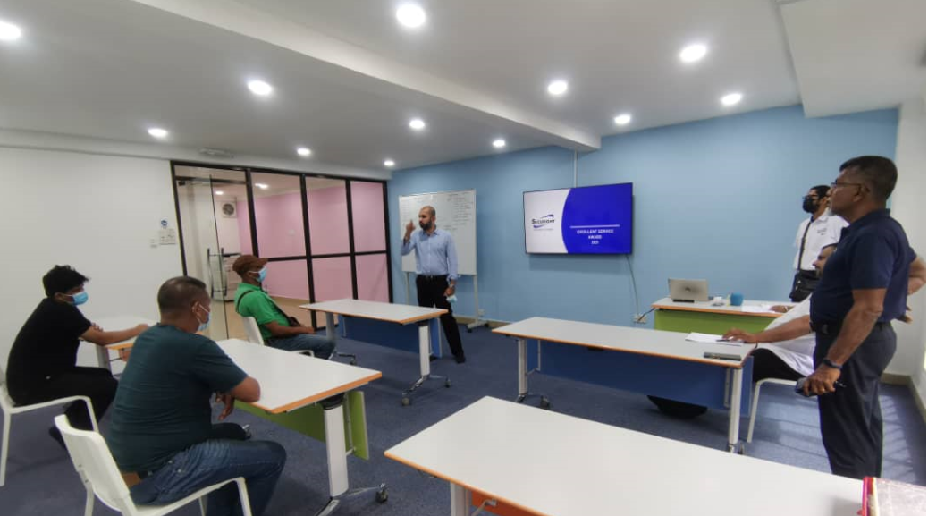
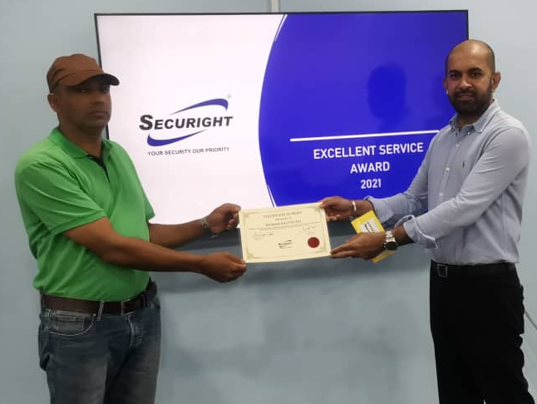
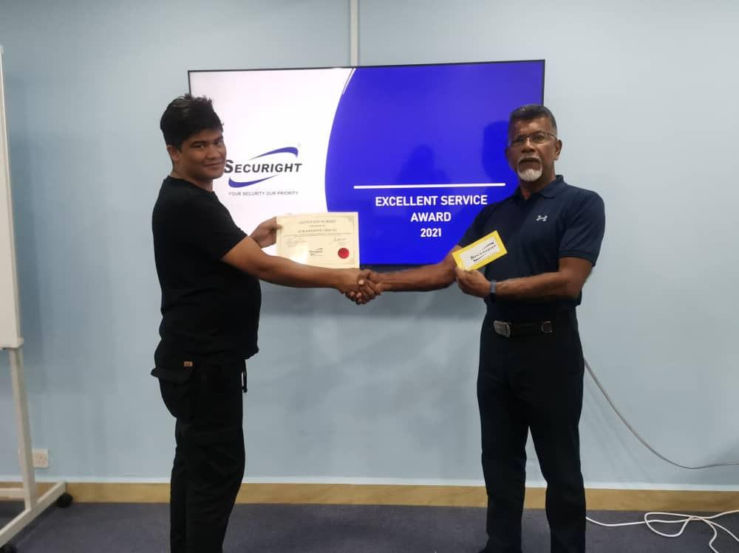
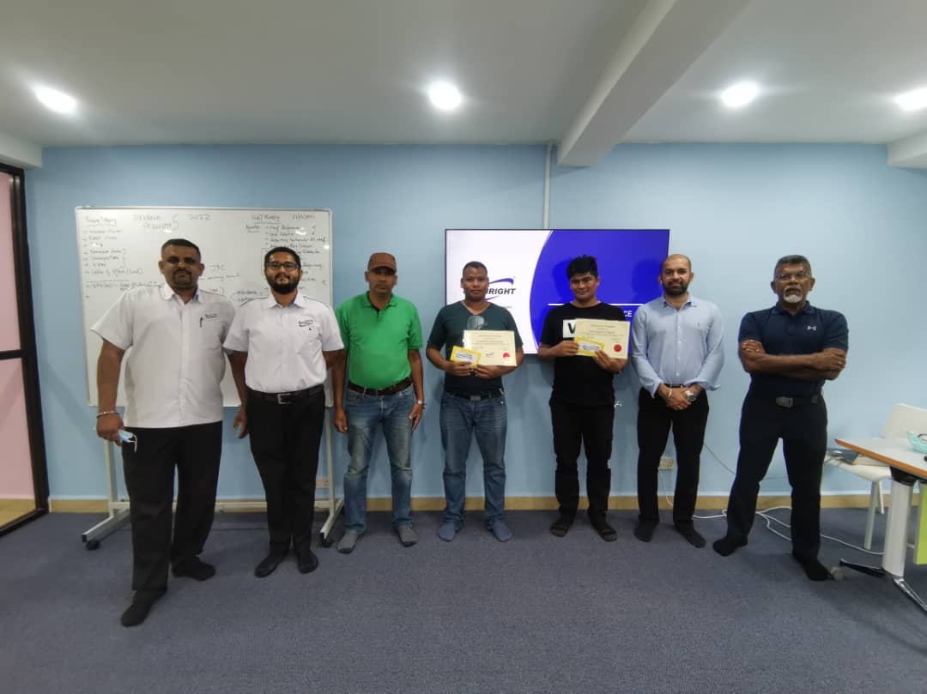
SECURIGHT CARE PROGRAM (SC-Program)
Securight has over the years, been extremely concerned over the wellbeing of our Guards. We have taken measures to ensure our Guards are provided with all amenities and ensured that their living conditions are comfortable and this is a continuing priority extended to our Guards.
It was with these concerns of their welfare that prompted us to go further and secure the RBA Code of Conduct certification and awareness. As a natural progression we promulgated SCP, to address the shocking statistics of Nepalese guards falling victims to stress and depression with dire consequences leading to fatalities.
Securight decided to embark on a Holistic approach and address the Mental Fitness as a vital and complimentary component to Physical wellbeing and along with Health care and adequate Training the Guards work ability / performance can be sustained and or improved.
In light of the physical and psychosocial demands on the guards we have engaged M/s Drona Dewi a well-established Trainer and Licensed Mental Health first aider and a practitioner of wellness programs to help us ensure that our Guards both Local and Foreigners are mentally able to cope with the demands at work and the emotional imbalance of being away from home.
SCP addresses inductee’s ie new arrivals from Nepal and thereafter follows up with a weekly / monthly or bi monthly Care programs.

Slide 16

Securight not forgetting the human aspect and humanitarian needs of all our staff and guards, we have set up a Wing called SECURIGHT CARE PROGRAM(SCP) this Wing primarily looks into a holistic approach to empathize and care for the mental and physical wellbeing of our Guards and Staff. Programs are conducted at site and at our Training center at HQ by our Mental Health First Aider Wellness Coach M/s Drona Dewi.
SECURIGHT CARE PROGRAM

Slide 17
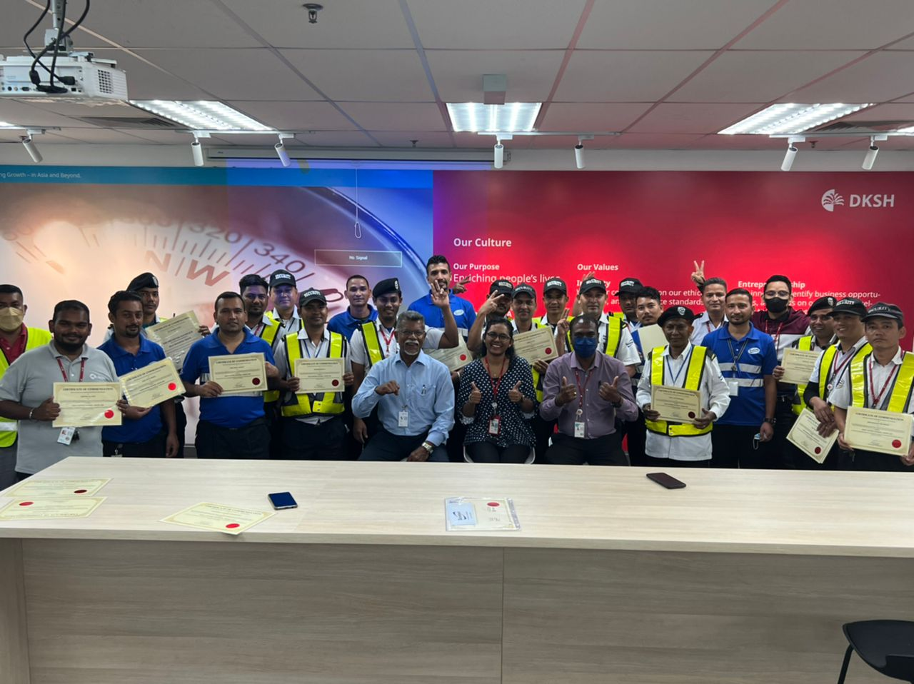
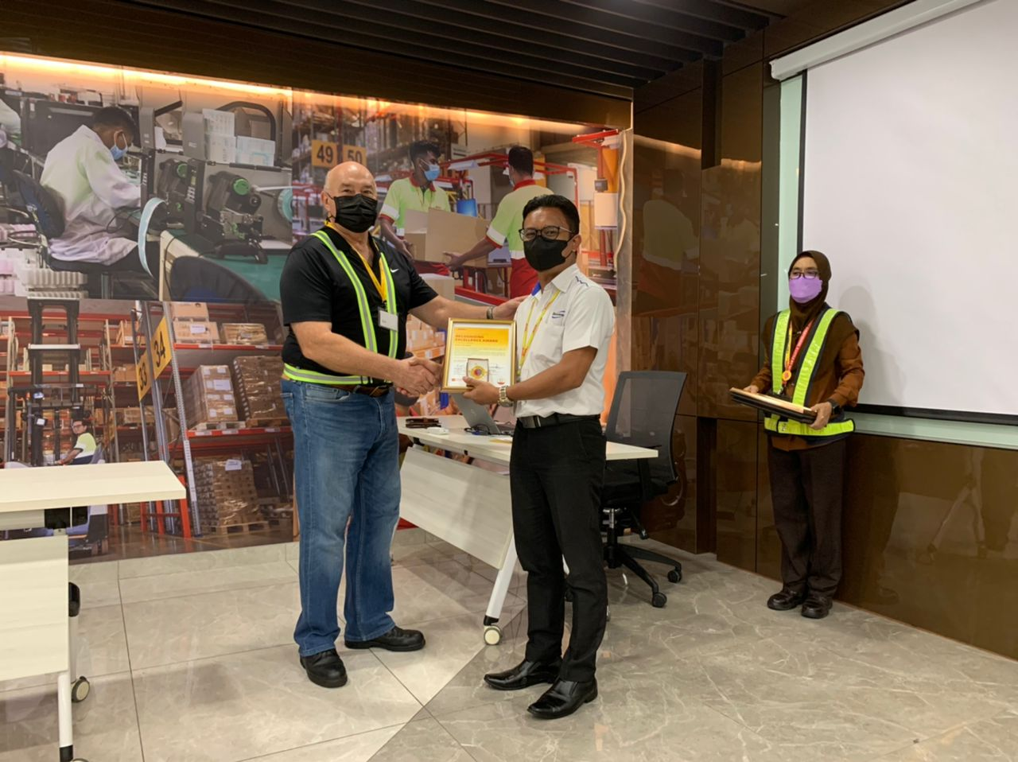
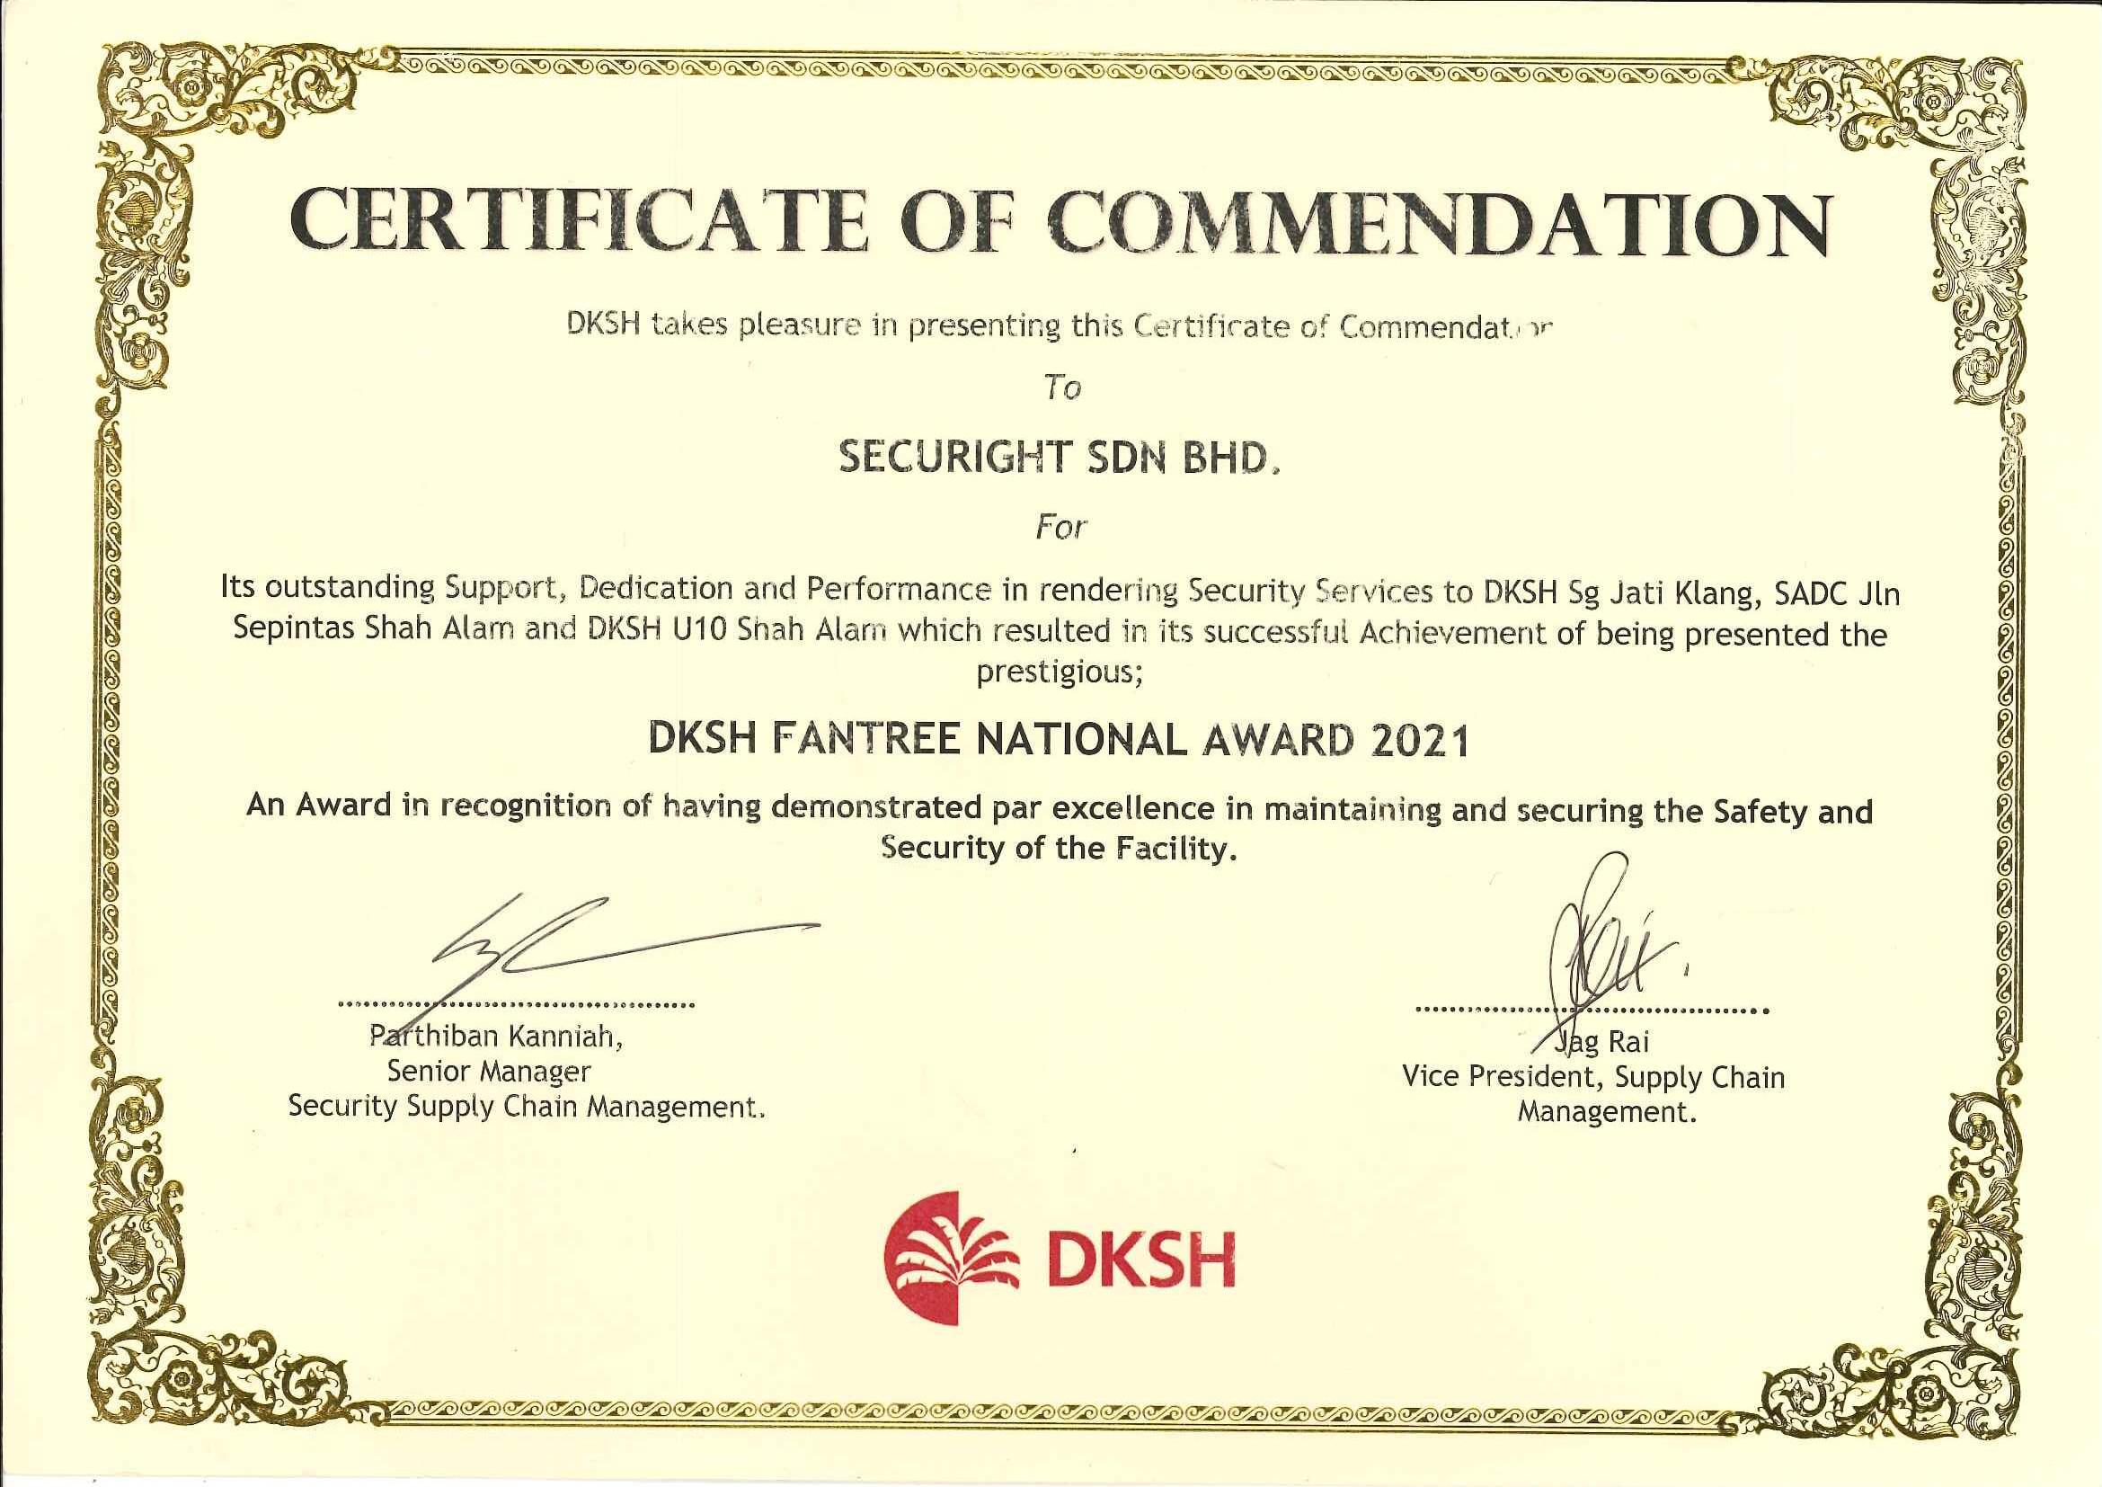
COMMENDATION AWARDS

Slide 18
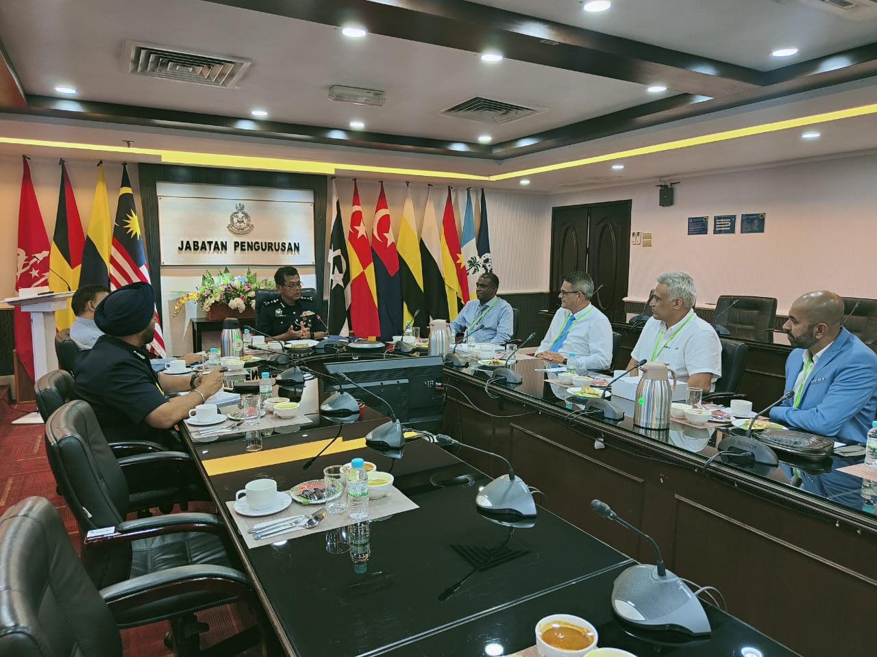
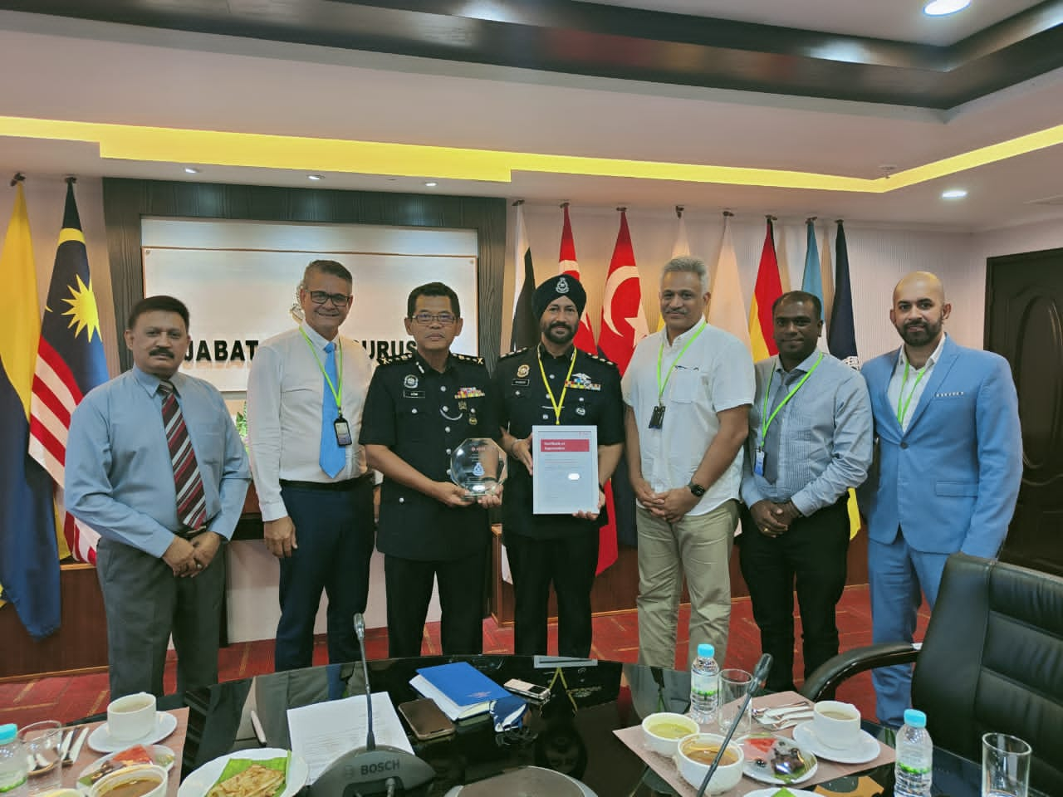
POLICE LIAISON
Based on circumstances and Security requirements we will also be able to provide Police ad-hoc patrols to the site. Our long term relationship with Police is on the basis of quid pro quo and it provides a viable and effective deterrent against any nefarious activities within the Site.

